Slide 1
Bellabeat case
“Bellabeat is a high-tech company that manufactures health-focused smart products. They offer different smart devices that collect data on activity, sleep, stress, and reproductive health to empower women with knowledge about their own health and habits.” (https://www.kaggle.com/code/macarenalacasa/capstone-case-study-bellabeat/notebook)
For this study, 33 users of the gadget “Fitbit” were asked to agree to share their personal tracker data, such as: physical activity, steps, sleep time, among others. The length of this analysis was of 31 days.

Slide 2

Through the use of Kaggle we found an interesting dataset with a considerable number of variables without being too heavy for it to run fast and efficiently but enough to draw interesting conclusions.

Slide 3
Questions to solve
Active users tend to sleep better?
How does sleep affect activity levels and calorie burn the next day?
Are people more active and burn more calories on days when they get more sleep?
Are there certain times of day when people tend to be more active e.g. before work, after work, during lunch?
Is the smart watch efficient enough to detect when users are sleeping, walking or doing any other high intensity activity?
Are active users constant in their regular activities?

Slide 4
The data exploration and cleanup process
Examined 18 csv files from which we analyzed 8 in order to answer our initial questions.
Checked up for each database if it had null values.
Identified outliers.
Modified data frame date formats.
Merged different tables to assess correlation among variables.

Slide 5
The analysis process
Created categories to segment users based on their activity.
Analyzed the distribution of activity levels for each category independently
Used scatterplots to assess correlation between steps and sleeping hours for each level of activity.
Used histograms to measure which were the hours with more activity level.
Heatmaps allowed us to assess variability per user in three different levels of activities.
With the use of the boxplot we discovered that there is no consistency between the users' level of activity per day.

Slide 6
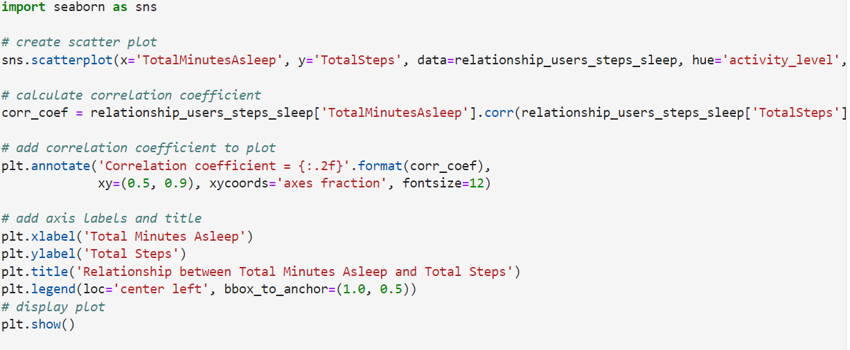
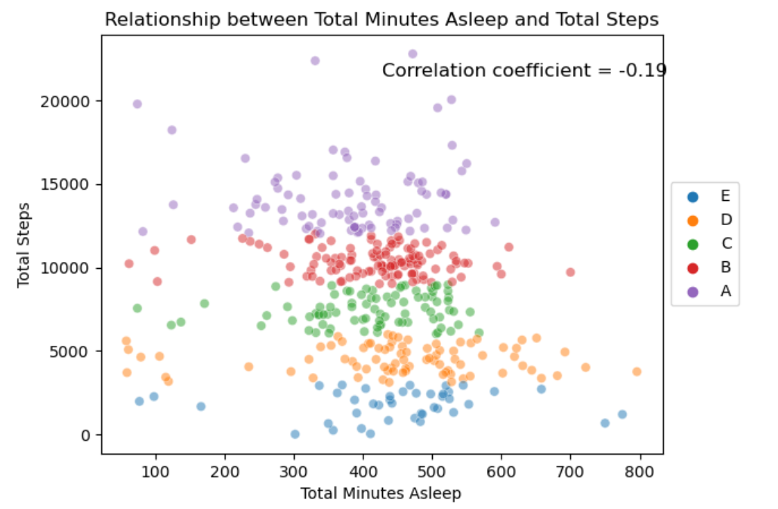

Slide 7
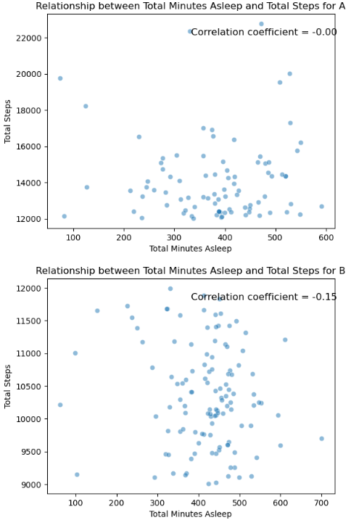
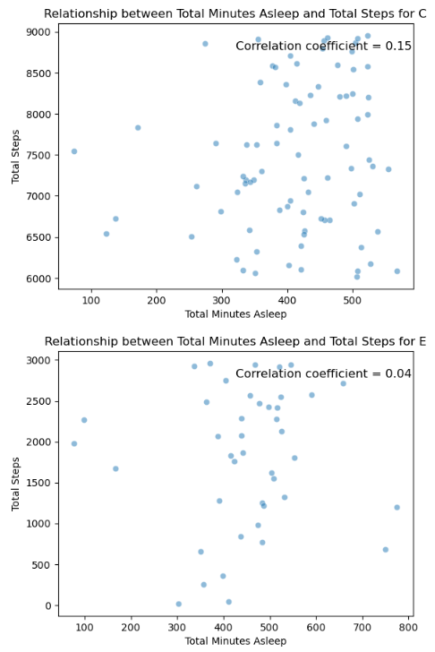
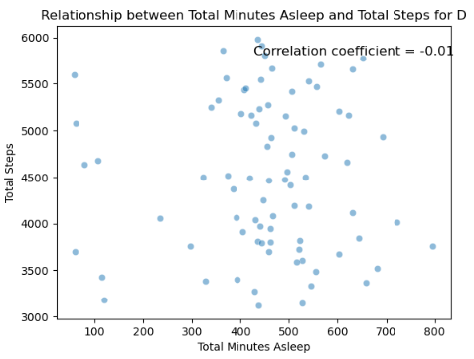

Slide 8
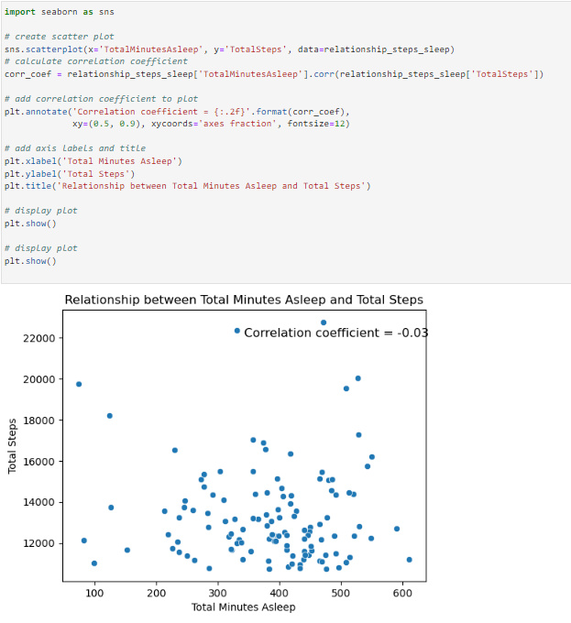

Slide 9
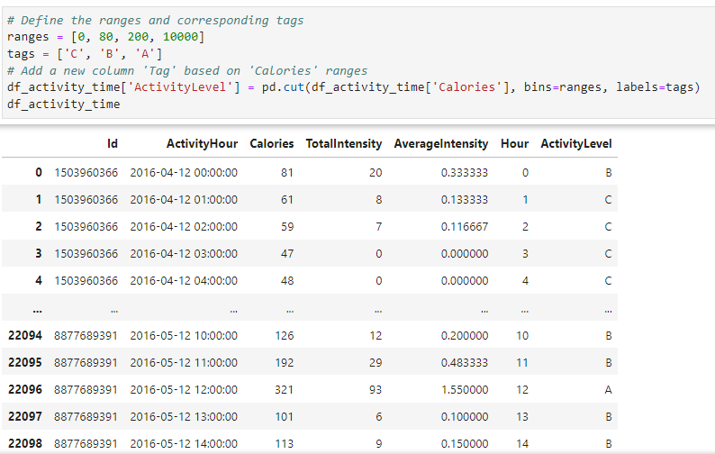
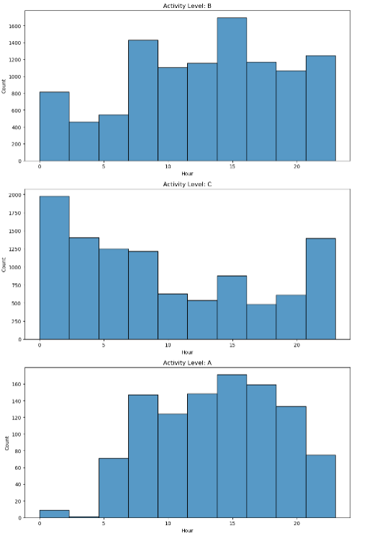

Slide 10
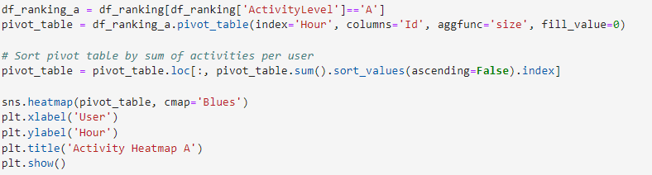
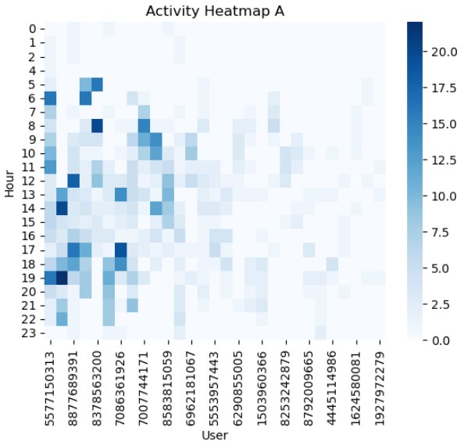
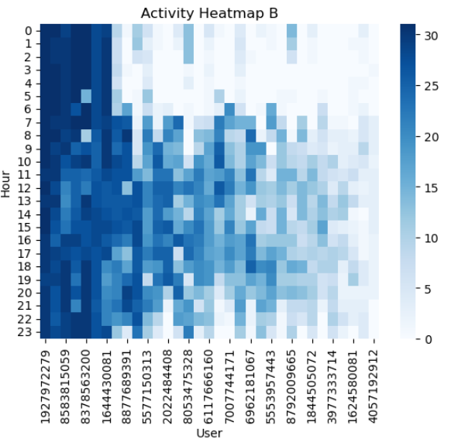
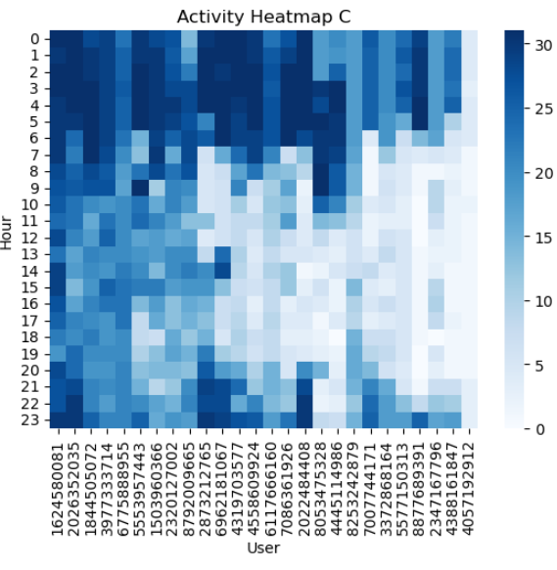

Slide 11
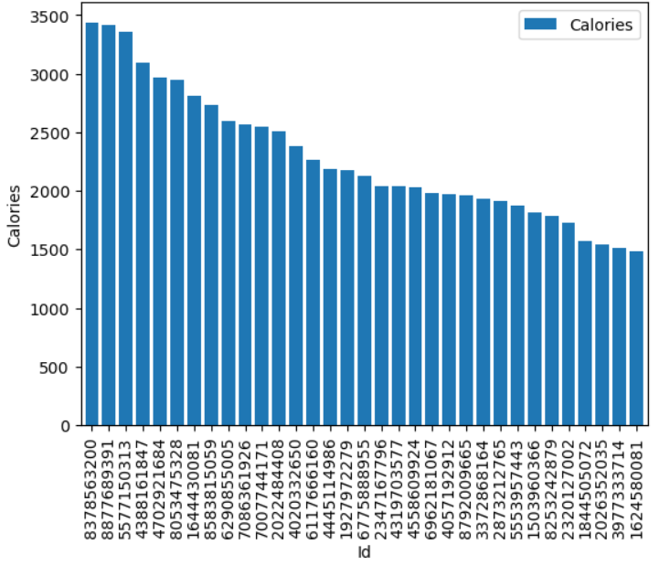
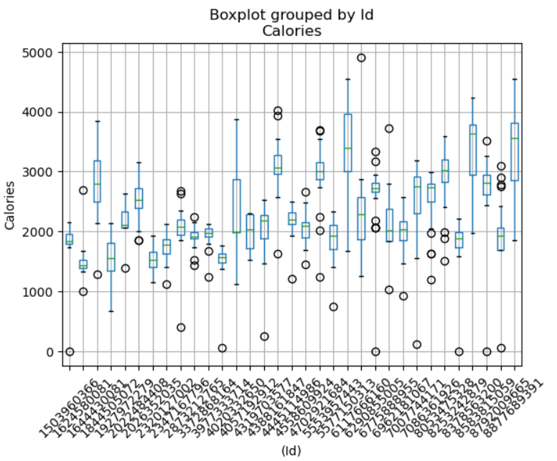

Slide 12
Conclusions
Overall relationship between total minutes asleep and total steps show a correlation coefficient of -0.19 meaning there is a weak or no correlation at all.
Activity among users is highly variable for example the same user sometimes can burn more than 4000 calories while in less active days it burns around 2000.
Activity levels differ among the same users and even more when compared to other users.
More than half of 33 participants evaluated burn more than 2000 calories per day.
In some cases, the Fitbit doesn’t track accurately sleeping times.

Slide 13
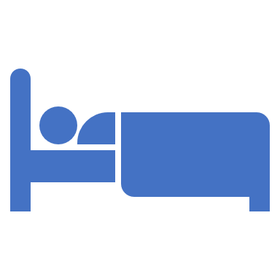
Findings
The Fitbit efficiently tracks activity per hour.
Not because someone sleeps more time, means that their day will be more active (calorie based).
Making the users aware of their activity consistency could help them to change their habits.
We cannot state that there is a pattern at the time of the day in which people do exercise.
Users who burn 2500 calories per day tend to be more active.

